Slide 1
Research of High-speed Multipliers Based on Rocket-chip
Group Members:
Hu Mingtao
He Wenxin
Xu Dongfan
Chen Ningtong
Zhou Liangmin
Dai Liuyao

Slide 2

Overview of our goals
Modify
Our High-speed multiplier
Rocket-chip
Notes:
乘法器是微处理器中进行数据处理的关键部分。
很多经典算法，特备是机器学习中计算机视觉，语音信号试别，自然语言处理等领域中使用的卷积，相关，窗口以及FFT等需要频繁进行大数据量的乘法运算。
因此乘法器完成一次操作的周期基本上决定了整个系统的运行速度。
乘法器的速度，面积和功耗的优化对于微处理器来说是非常重要的。

Slide 3
Overview
We launch our research on 2 aspects:
Part I: Study of Multipliers and Implementation in HDL
Multipliers study & Verilog design & Simulation
Part II: Override Multiplier with Modified Chisel
Learning Rocket-chip: Waveform Debug and Modified Chisel
Others: Paper Research
Find some more advanced architectures

Slide 4
CONTENT
I. Background Review
Very brief review of RISCV and fast multiplier
II. Study of Multipliers and Implementation in HDL
i) Various Classification of Digital Multipliers
ii) Baugh-Wooley Multiplier
iii)* 64-bit Floating-point multiplier in HDL
III. Override Multiplier with Modified Chisel
i) Override Multiplier with BW algorithm
ii) Waveform debug

Slide 5
Ⅰ. Background Review

Slide 6
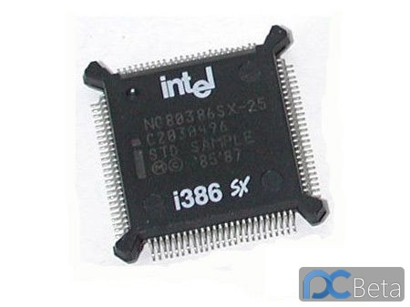
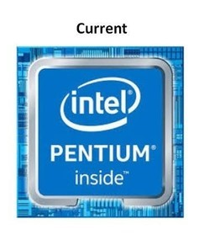
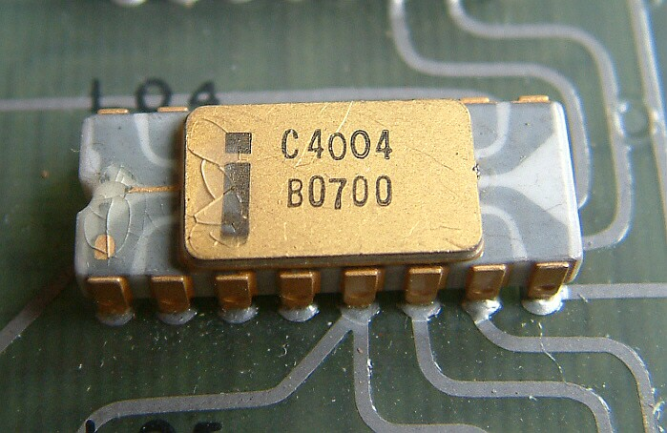
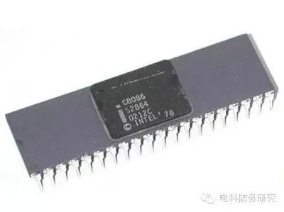
Ⅰ. Introduction of project - Background and Goal
i) Background
With the development of microelectronics，digital signal processing chip has fast developed since 80s.
Multiplier play a important role in a DSP chip in iterative multiplication, it can decide the complexity of cycle program. It can decide the speed of DSP chip.
The goal of this project is to study the performance of algorithmic coding unit, area and power consumption of various structures, and choose a method to improve the performance of multiplier in rocket-chip’s ALU.

Slide 7
Relative paper
Performance Analysis of Karatsuba Multiplication Algorithm for Different Bit Lengths(2015)
Enhanced high speed modular multiplier using karatsuba algorithm(2013)
Some new results on binary polynomial multiplication(2015)
Novel bit-parallel multiplier for GF ( 2 m ) defined by all-one polynomial using generalized Karatsuba algorithm(2014)
Sub-Word Parallel Precision-Scalable MAC Engines for Efficient Embedded DNN Inference
ENVISION: A 0.26-to-10TOPS/W Subword-Parallel Dynamic-Voltage-Accuracy-Frequency-Scalable Convolutional Neural Network Processor in 28nm FDSOI

Slide 8
II. Study of Multipliers and Implementation in HDL
Various Classification of Digital Multipliers
Baugh-Wooley Multiplier
* 64-bit Floating-point multiplier in HDL

Slide 9
Preliminary Investigation

Slide 10
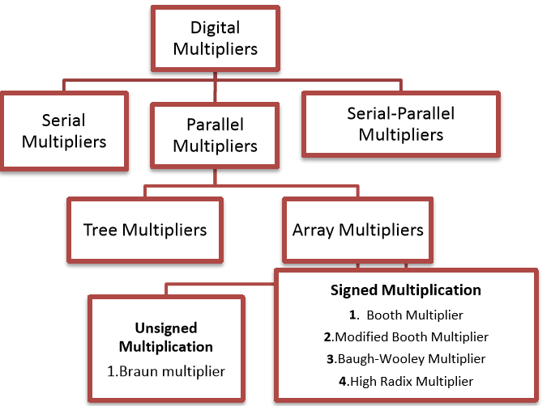
Various Classification of Digital Multipliers

Slide 11
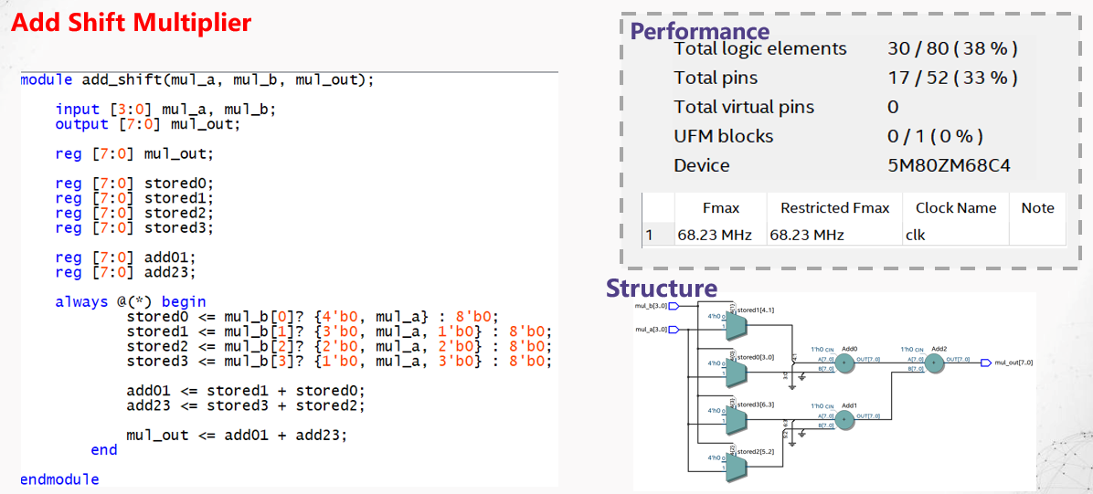
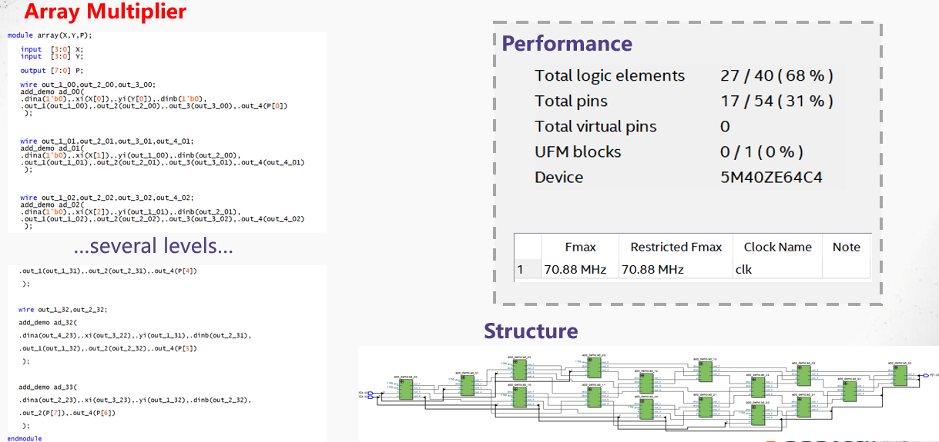
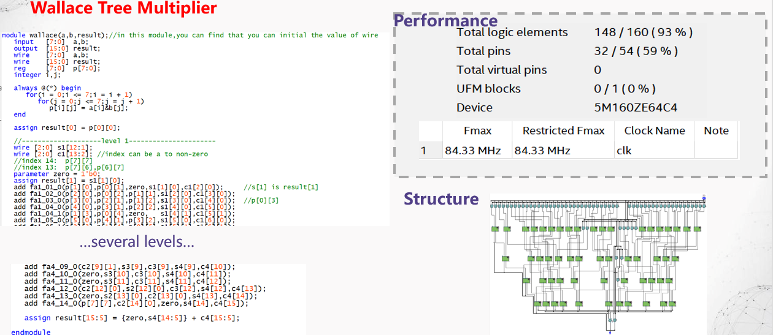

Slide 12
Various Classification of Digital Multipliers
We want to deal with signed bits….
our goal

Slide 13
Baugh-Wooley Multiplier

Slide 14
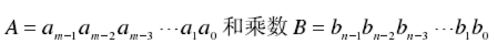
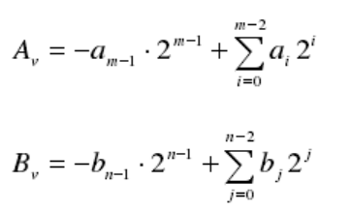
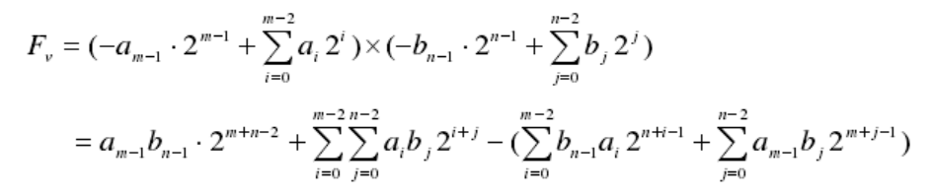
Introduction of Algorithm
Baugh-Wooley algorithm
Two signed numbers, A (m-bit) and B (n-bit).
Their product is F

Slide 15
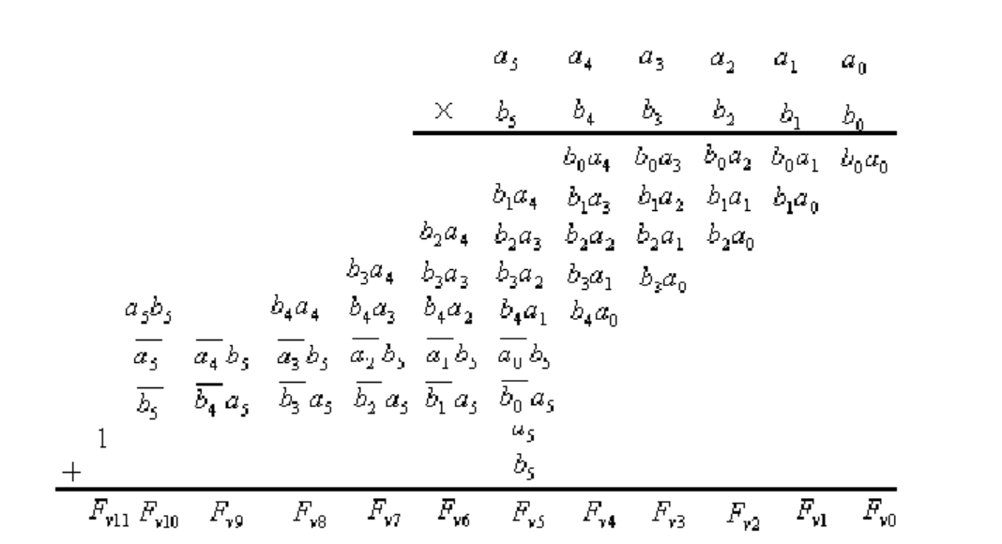
Introduction of Algorithm
Baugh-Wooley algorithm
Baugh Wooley algorithm is a kind of algorithm that directly multiplies the complement.
sign

Slide 16
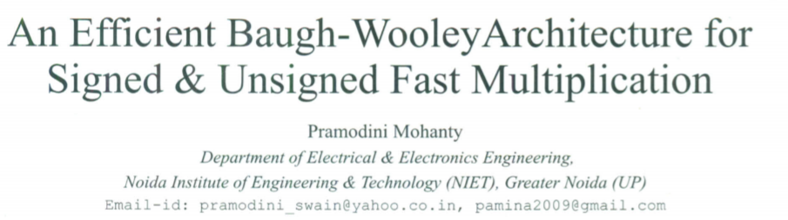
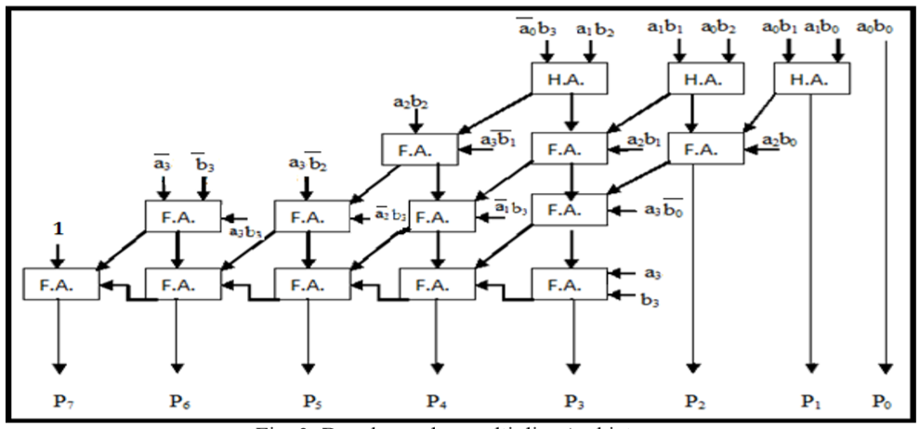
Hardware Architecture
Architecture I :
PramodiniMohanty ,VLSIDesign, Department of Electrical &Electronics Engineering Noida Institute of Engineering & Technology 2011-2012:” An Efficient Baugh-WooleyArchitecture forBothSigned & Unsigned Multiplication”, PramodiniMohanty et al./ International Journal of Computer Science & Engineering Technology (IJCSET)

Slide 17
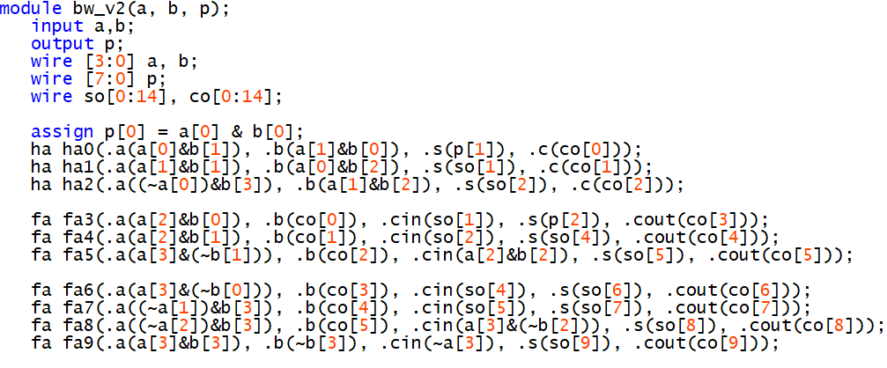
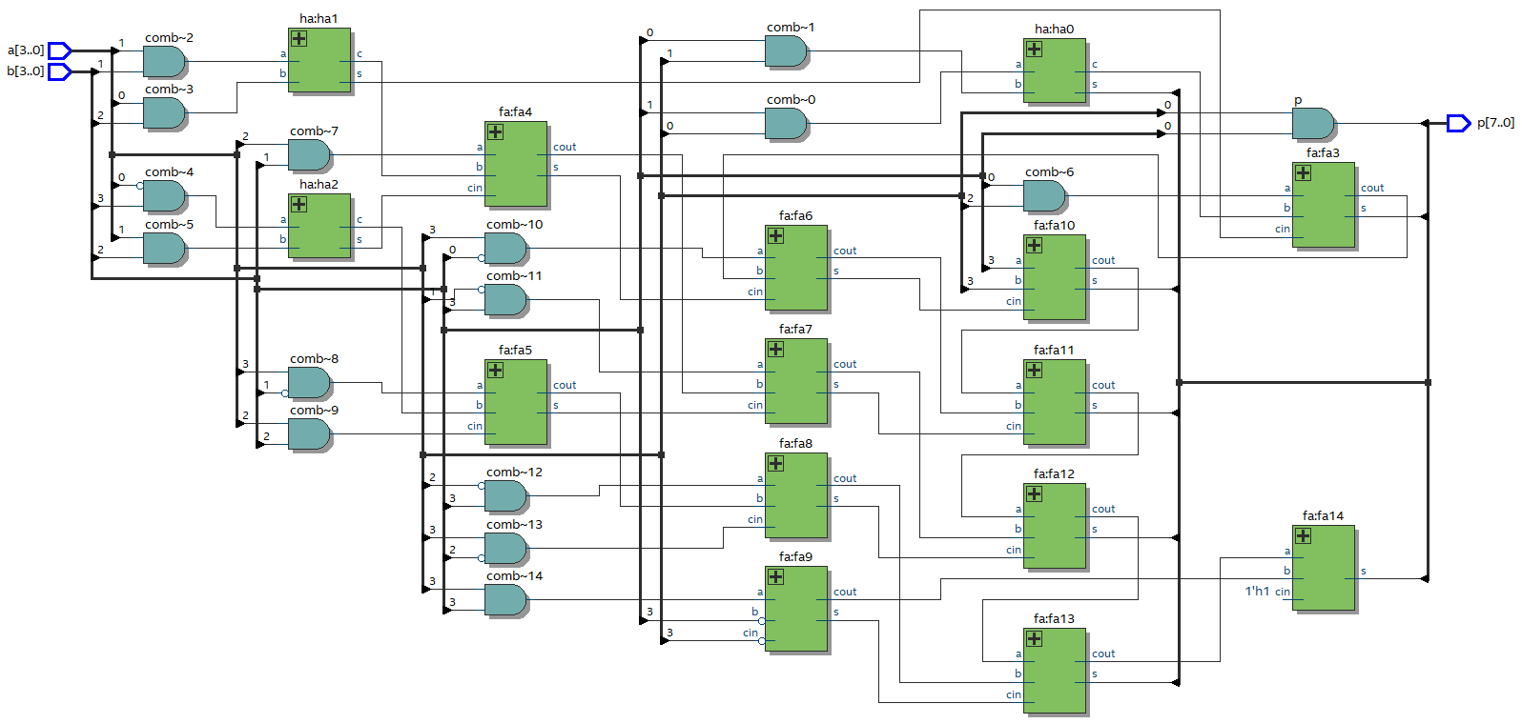
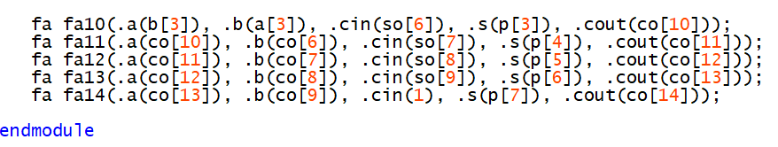
Hardware Architecture
Implementation and Results
(Architecture I)
Verilog Codes
RTL View

Slide 18
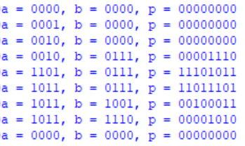
Hardware Architecture
Implementation and Results
(Architecture I)
Simulation

Slide 19
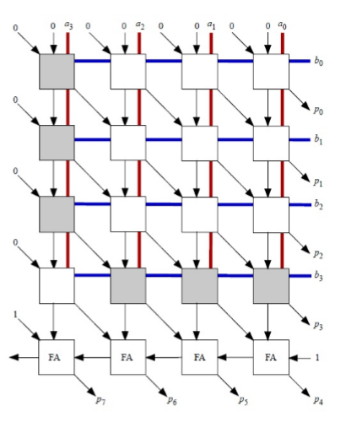
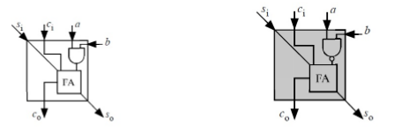
Hardware Architecture
Architecture II :

Slide 20
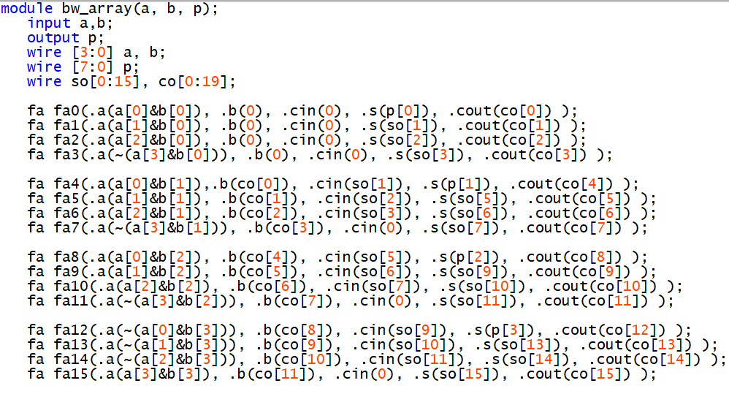
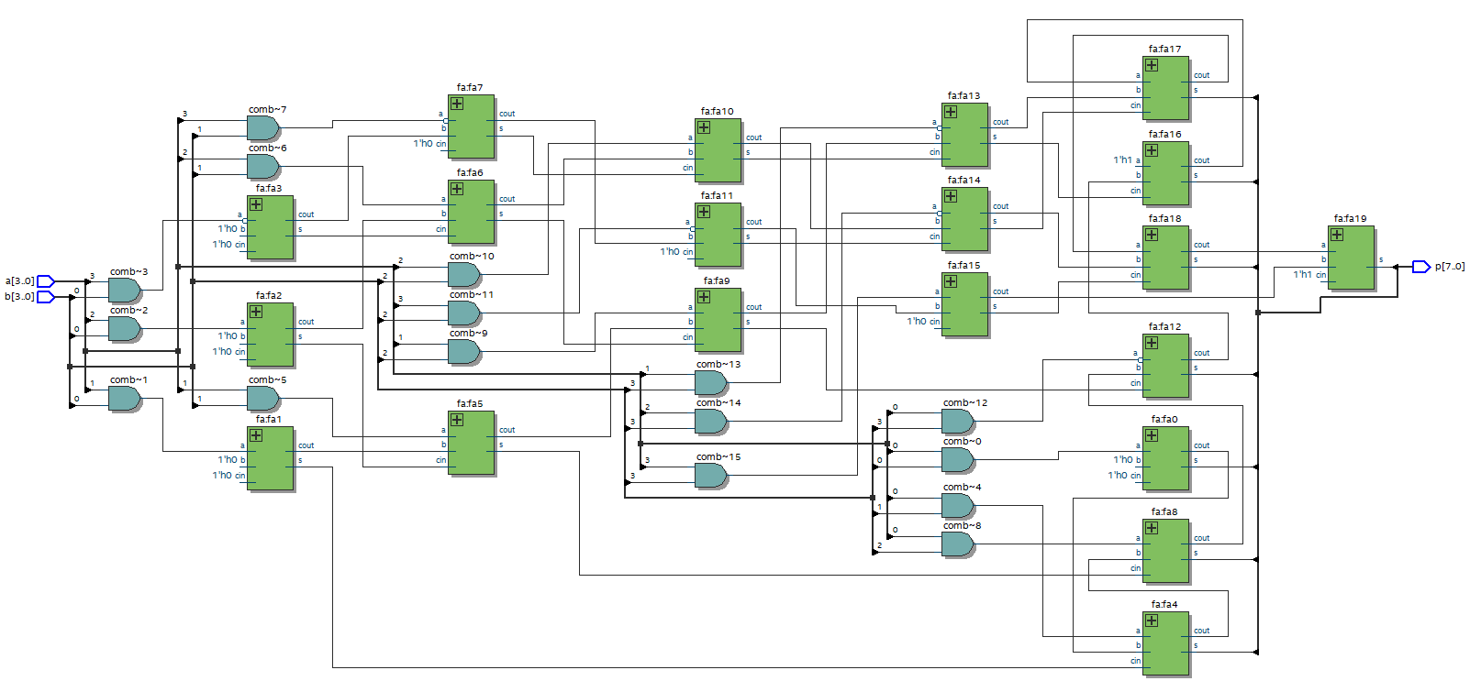
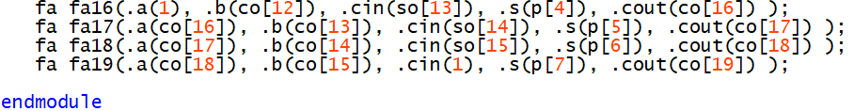
Hardware Architecture
Implementation and Results
(Architecture II)
Verilog Codes
RTL View

Slide 21
Hardware Architecture
Implementation and Results
(Architecture II)
Simulation

Slide 22
Comparison between architecture I and II

Slide 23
*64-bit Floating-point multiplier in HDL

Slide 24
IEEE754 Floating-point Standard
Basic Format
 | 符号/1位 | 阶码/8位 | 尾数/23位
NaN | 0/1 | 11111111 | 非0
无穷 | 0/1 | 11111111 | 23’b0
0 | 0/1 | 00000000 | 任意
正常 | 0/1 | （0，255） | 任意
NaN * X = NaN
±∞ * 0 = NaN
±∞ * X = ±∞
0 * X = 0

Slide 25
IEEE754 Floating-point Multiplier
Operation
A_sign ⊕ B_sign
A_exp + B_exp - 1023
Operation

Slide 26
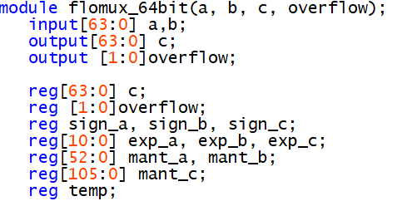
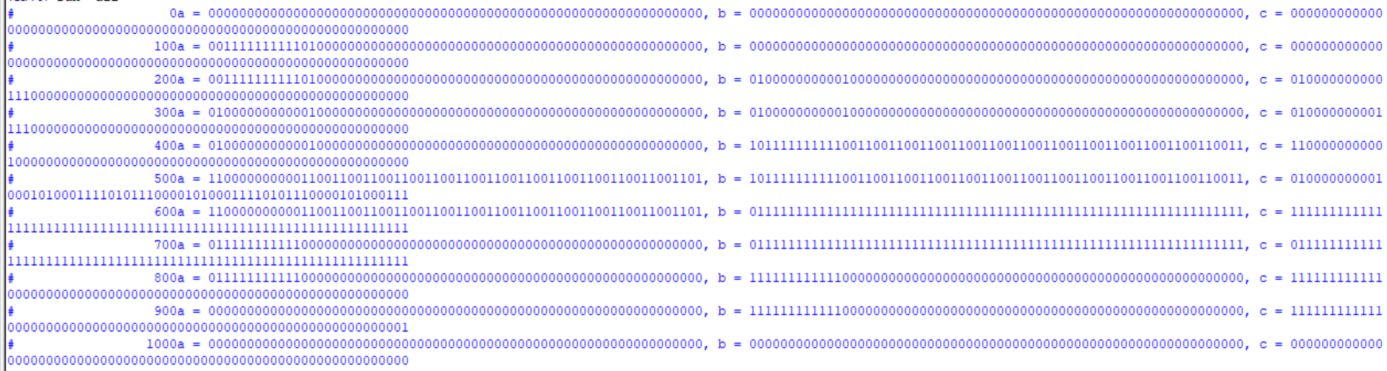
Simulation Result

Slide 27
III. Override Multiplier with Modified Chisel
Override Multiplier with BW algorithm & Waveform debug

Slide 28
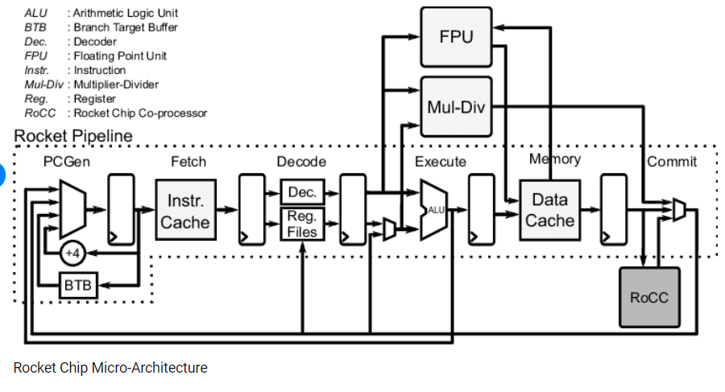
Hardware Architecture
Rocket Chip Micro-Architecture
One of our goal

Slide 29

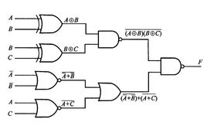
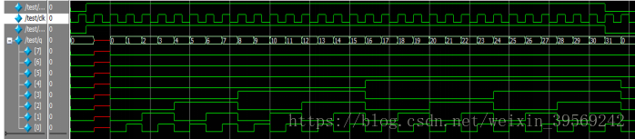
Hardware Architecture
VCD waveform generation
Chisel
Verilog

Slide 30
Run Through Rocket-chip generator
Two way to compile .c file
从github下载rocket-chip和rocket-tools代码
进入rocket-tools路径，运行build.sh，将riscv-gnu-toolchain添加到系统路径，检查riscv-gcc，成功则可进入下一步。
进入rocket-chip目录，进入emluator目录，运行make，生成emulator-freechips.rocketchip.system-DefaultConfig 仿真器的程序。
仿真C程序: 在/riscv-tools/riscv-tests/benchmarks的项目目录创建C代码，修改Makefile中的bmarks变量为项目目录名称，编译后得到.riscv文件，将.riscv文件移动到emulator目录下，利用生成好的仿真器程序运行.riscv文件，生成仿真结果和逻辑图仿真
进行电路仿真，进入/rocket-chip/src/main/scala目录下，修改Configs.scala的核心配置定义，构建rocket-chip的核心代码，进入emulator重新编译CONFIG=src/main/scala/coreplex/Configs.scala中定义好的类名，得到新的芯片仿真器，重复以上流程。

Slide 31
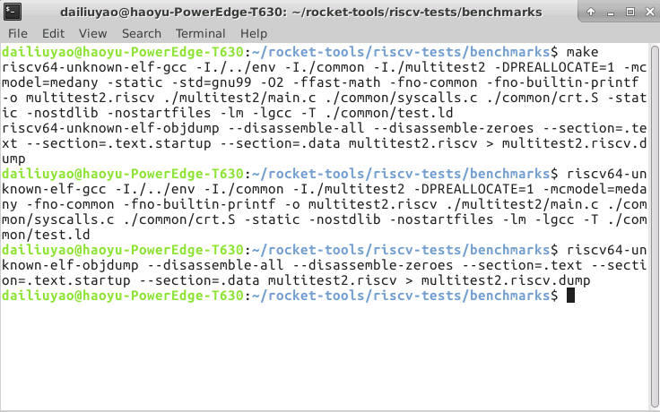
删除，防止运算过程被优化省略

Slide 32
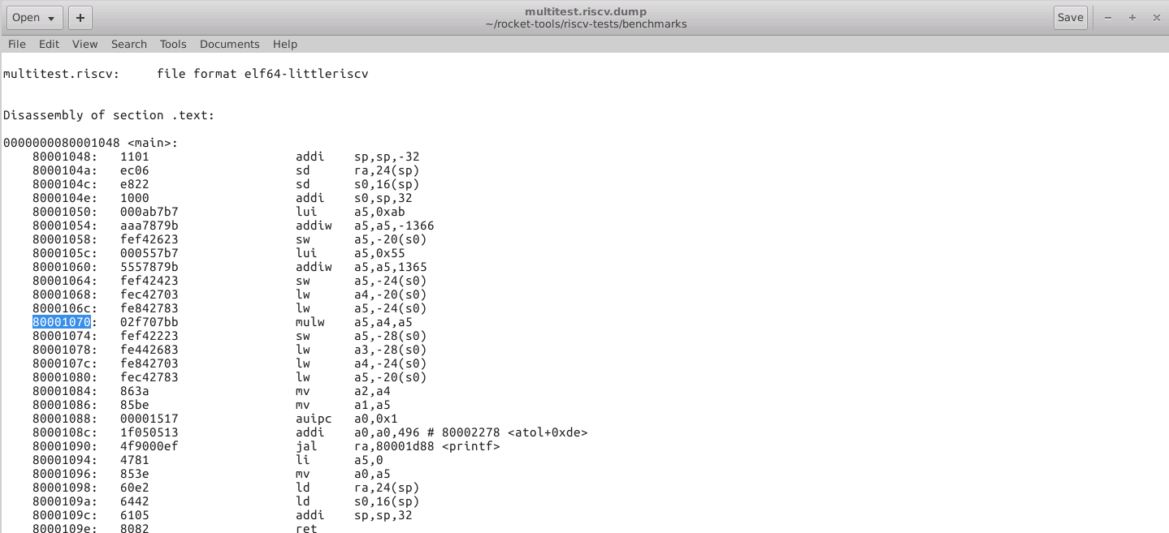
反汇编找到乘法的指令序号

Slide 33
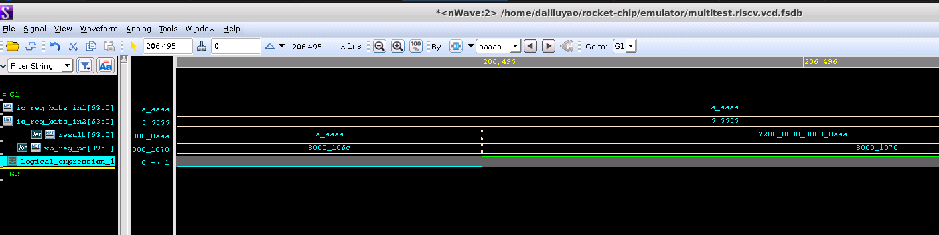
在波形图中找到进行乘法的波形信号

Slide 34
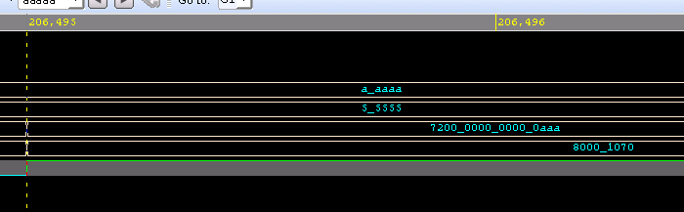
在波形图中找到进行乘法的波形信号

Slide 35
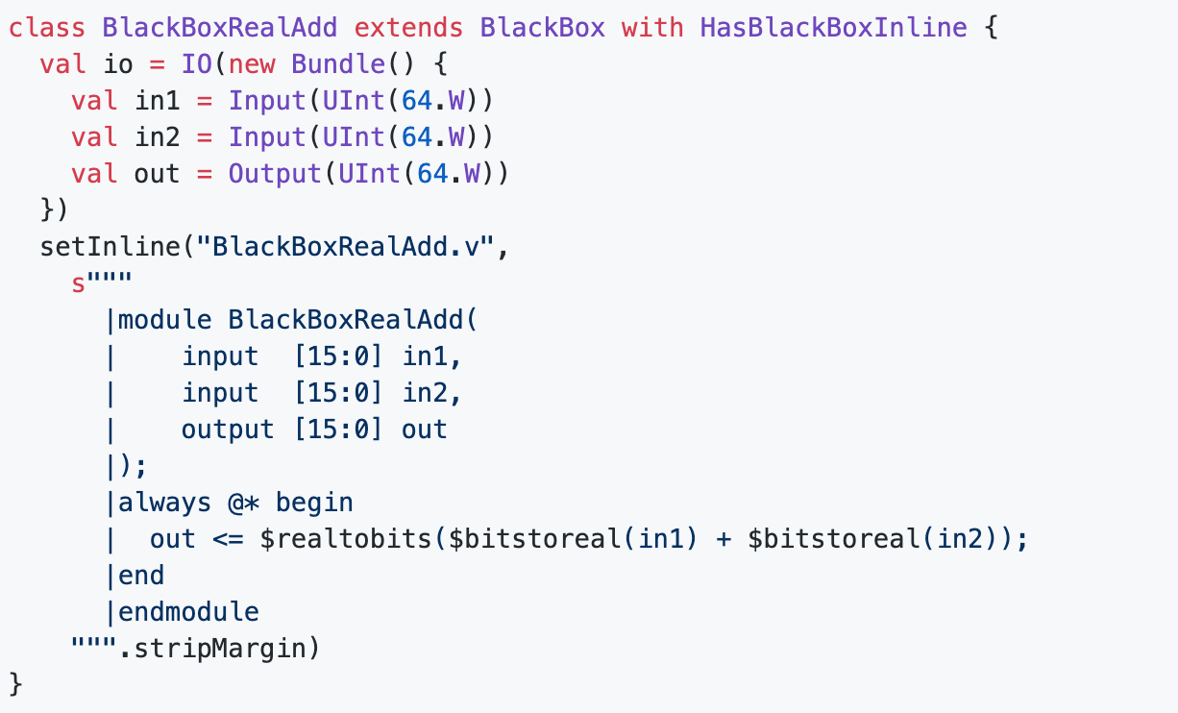
Override Multiplier with BW algorithm
Disadvantages of inserting verilog statement
Not convenient

Slide 36
Override Multiplier with BW algorithm

Slide 37
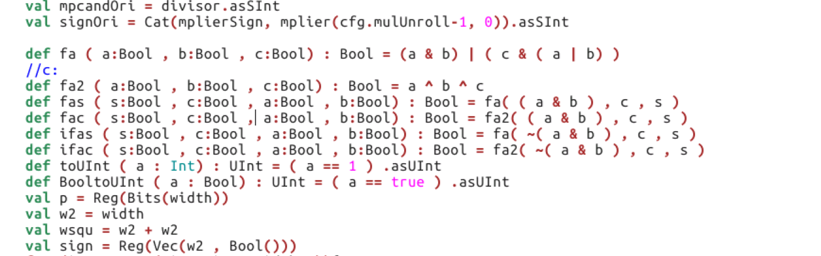

Slide 38
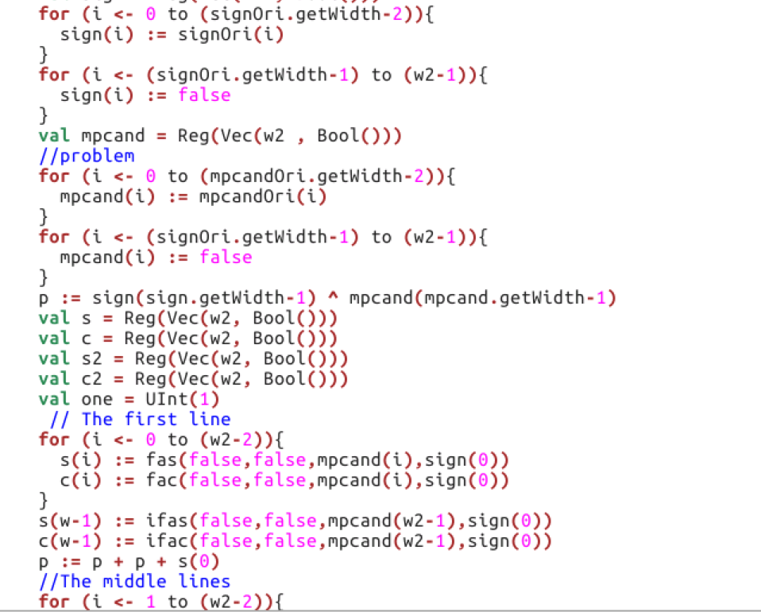

Slide 39
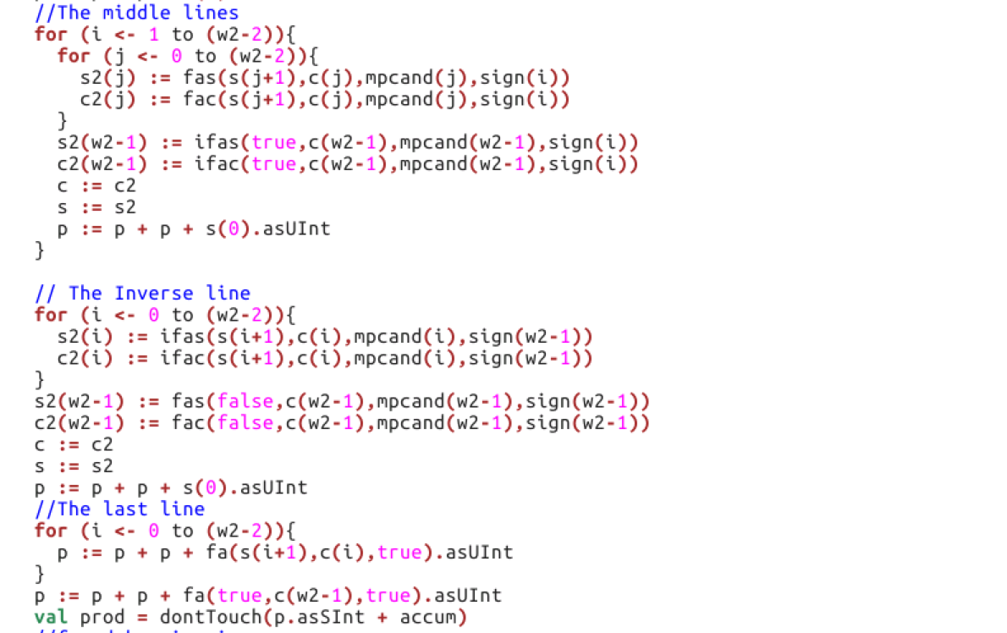

Slide 40
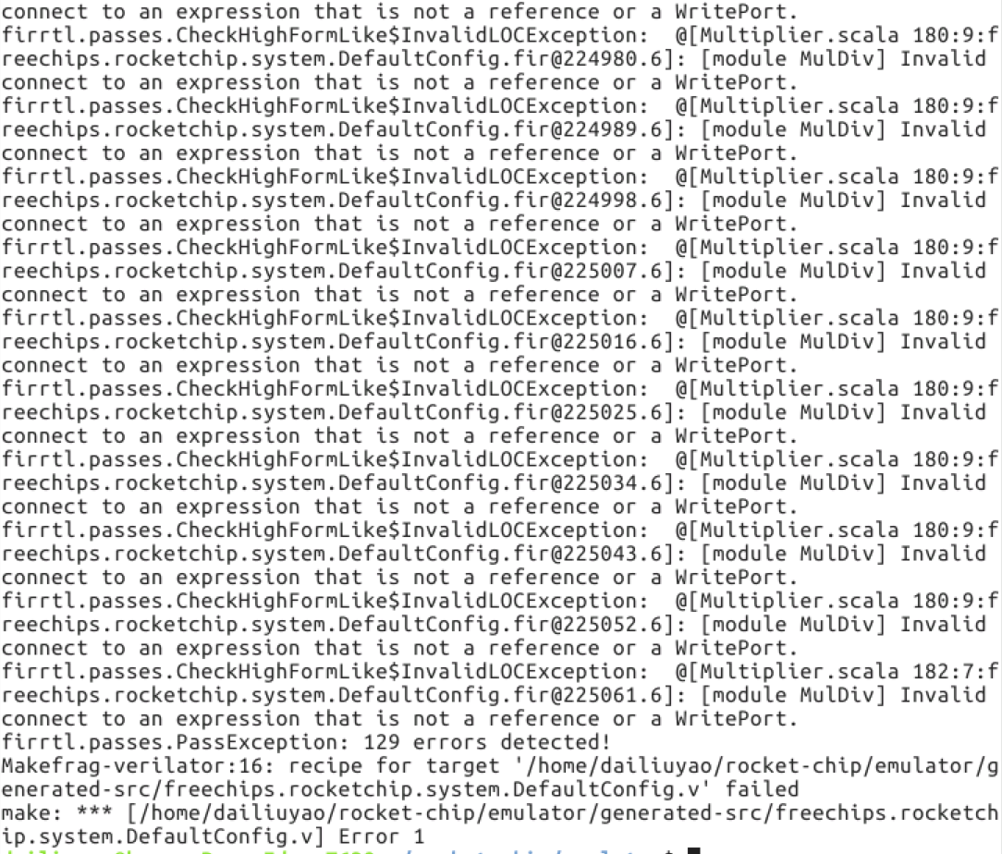

Slide 41
Main errors (solved)
Syntactical errors
Variables are not compatible
Overflow
The code could not be translated into the circuit

Slide 42
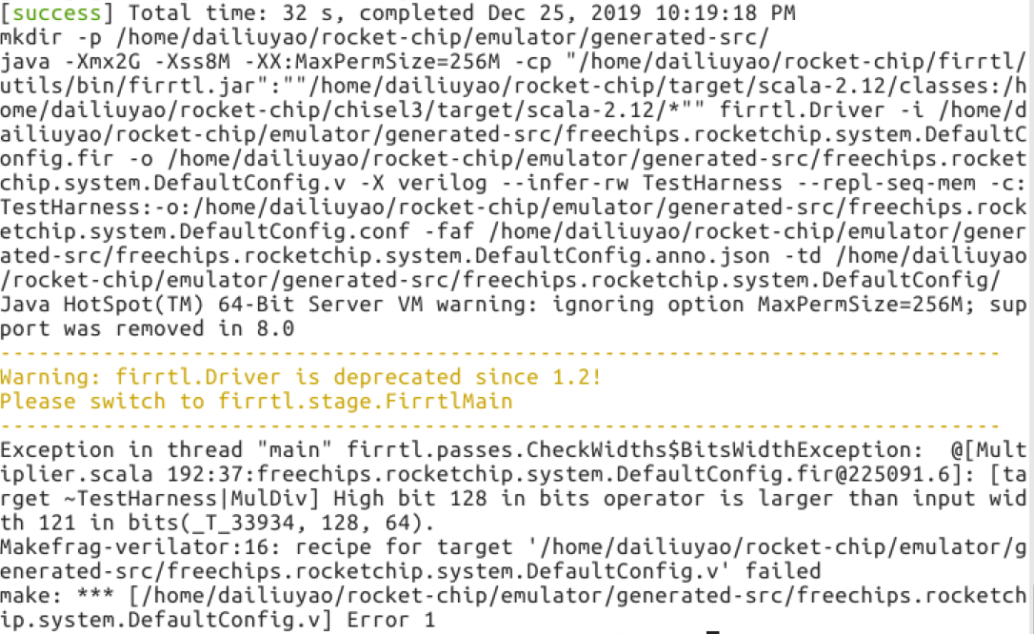
Exist in the beginning
Success！

Slide 43
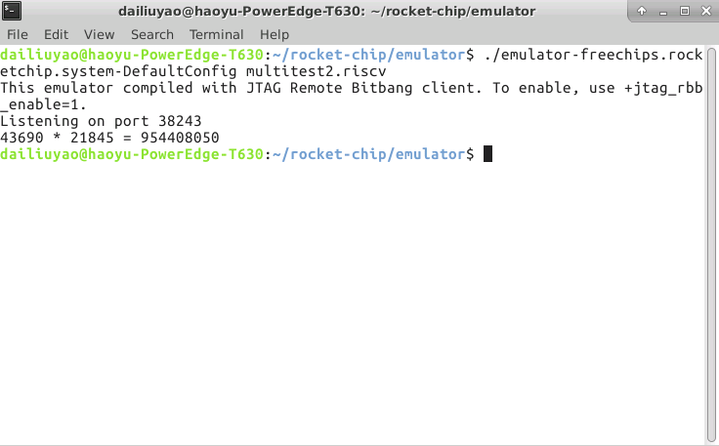
x0aaaa * x05555
The result is correct

Slide 44
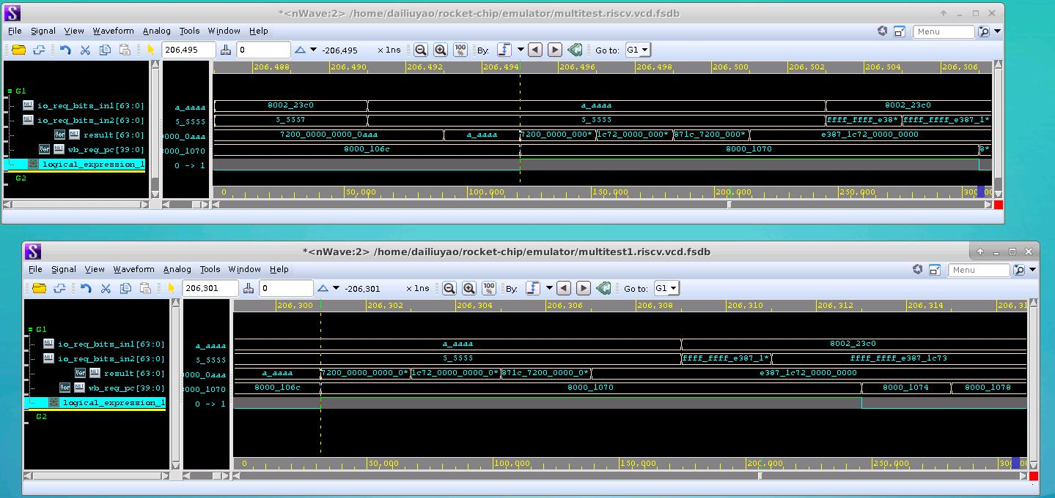

Slide 45
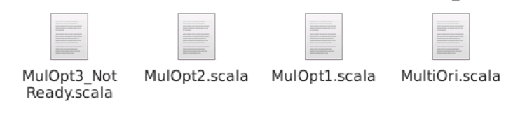
Improved version

Slide 46
Remaining problems
Code style
Registers can still be reduced
Bit width of operation

Slide 47
Thanks
Q & A

